Slide 1
Teaching Students Project Management
Dr. Bill Oakes, EPICS Director
Pamela Dexter, EPICS High School Coordinator
2011

Slide 2
Outline
Integrating design and project management
Team Roles
Flow charts
Materials lists
Chronogram
Follow up meetings
Adjustments
Notes:
The design thought process is very universal. Can be used to solve complex design problems or simple problems. We will try our best to demonstrate and draw parallels between project management and the design process.

Slide 3
Project Plans
Among the many questions that can be addressed with a plan are:
What do you and/or your team does first?
What should come next?
How many people do you need to accomplish your project?
What resources do you need to accomplish your project?
How long will it take?
What can you get completed by the end of the semester or quarter?
When will the project be finished?
How will we know we are done with the project?
Notes:
Here are some of the questions you will usually encounter when planning projects. The biggest ones that I struggle with do this day are: what in the world do I do first, how long will it take, or what can be done by the end of the semester. You know your ideal schedule vs the practical one. Today we will discuss some of the ways to answer some of these questions without becoming overwhelmed. The best place to start is with the design problem [next slide]

Slide 4
It is your guiding light.
DESIGN CHALLENGE (PROBLEM)
Notes:
Roy
Extremely important to have a understanding of the design problem. I like to call it the design challenge, it just gets me motivated and ready to go. Although it may be classified as an ill-defined problem, a grasp of the situation will allow you or your students to start to put some bounds around the problem and allow planning.

Slide 5
Defining Project Scope
What is the work that will be done
Scope management plan
How will the scope be defined, managed and controlled?
How will the scope be communicated to the team and stakeholders/community partners?
Scope creep
Incremental expansion of the project scope
Introducing features not originally planned
Delay project and add cost
Notes:
Understanding the scope of the project follows from understanding the design challenge, and research has shown that spending quality time in project scoping is positively correlated to quality designs. So very important for students to understand the scope of the project because it can also deter Scope creep. Which is when students keep expanding the bounds of the project. This may not entirely be their fault they may feel pressure from the project partner. But by the time you are ready to start planning this should be about done. If this continues throughout the project it can lead to feature-creep, which is where designers keep adding features to a product. Think about a copy machine, or heaven forbid a cell phone. Donald Norman who wrote, DOET said that one way to prevent this is to do hill-climbing.

Slide 6
Thought Hierarchy
DESIGN CHALLENGE
(PROBLEM)
OBJECTIVE 01
TASK 01
MATERIALS
TASK 02
MATERIALS
OBJECTIVE 02
TASK 03
MATERIALS
TASK 04
MATERIALS
OBJECTIVE 03
TASK 05
MATERIALS
TASK 06
MATERIALS
Functional Decomposition
Notes:
Drawing another link between design and project management. Your students or you yourself may not be able to break the problem completely down but it sets students up to know what questions to ask.

Slide 7
Creating a Project Charter
First Phase of the Design Process
The elements of a charter include:
Description Objectives
Outcomes or deliverables
Duration
Community Partners
Stakeholders.
Team membership and roles
Planning information
Revisit each semester during your semester plans
Notes:
Duration is hard to figure out especially for novel or new objectives.

Slide 8
Team Roles: Students
Team Leader/Co-Leaders – Organization of the team and project tasks
Project Leaders – If you have multiple projects you may need to break the leadership down into project leaders
Liaison – Primary contact with the community partner
Financial Officer – Manages the team’s budget
Webmaster – If your team would like to create a webpage you might want to assign a webmaster
Notes:
Examples of team roles high schools may utilize.

Slide 9
Pert Charts
Program Evaluation and Review Technique
Items are listed in blocks
What it is
Duration
Who is responsible
Used to determine what tasks can be done in parallel and what have to be done in series
Notes:
Pert charts are a good collaborative tool for the team leader and the advisor for planning. Tasks are listed in blocks along with duration and who is responsible for getting it completed. The strength of this strategy is that it helps visualize multitasking. Students can easily see what needs to be done sequentially and what can be done in parallel.

Slide 10
PERT Charts – Organizing Tasks
Review web pages on project schedule, 1 day
Attend lecture on project schedules - 1 day
Read about project schedules, 1 day
Create PERT and Gantt charts, 1 day
Start, receive assignment
Look at examples in MS Project, 2 days
PERT chart and timeline submitted
Identify Milestones, 1 day
Identify major component of project, 3 days
Estimate time for each task, 1 day
Notes:
Roy
Here is an example of using a pert chart to learn project management and create a pert chart for a project. The upper part of this particular pert chart shows parallel and sequential tasks. The bottom line of tasks represents the critical path, because if that doesn’t get done it holds up the completion of the final tasks. [go to chart]

Slide 11
Critical path
Longest string of dependent task in the project.
Tasks on the critical path will hold up the completion of the overall project if they are delayed.
Example: mathematics sequence in an engineering or science curriculum.
Delaying a semester of calculus class typically delays graduation for one semester.
Notes:
Critical path is a string of dependent tasks in the project

Slide 12
PERT Charts – Organizing Tasks
Review web pages on project schedule, 1 day
Attend lecture on project schedules - 1 day
Read about project schedules, 1 day
Create PERT and Gantt charts, 1 day
Start, receive assignment
Look at examples in MS Project, 2 days
PERT chart and timeline submitted
Identify Milestones, 1 day
Identify major component of project, 3 days
Estimate time for each task, 1 day

Slide 13
Critical Path
Special attention to tasks on the critical path
Milestone deadlines and when moving resources
Delays in critical path, delay the project
Which can not be shortened with more time or people?
Which are beyond your control?
e.g. depending on an outside vendor or supplier
Notes:
PERT Chart activity
So you have to pay special attention to tasks on the critical path especially if the tasks depend on other people and/or outside vendors.
Another question to ask yourself when considering the critical path is what can not be shortened with more time or people.
Now we are going to do a short exercise where you design your own pert charts. And what we would like you to do is get in groups of # and lay out the tasks need to do a service-learning celebration. What can be done in parallel, what needs to be done sequentially? And then we’ll come back together.

Slide 14
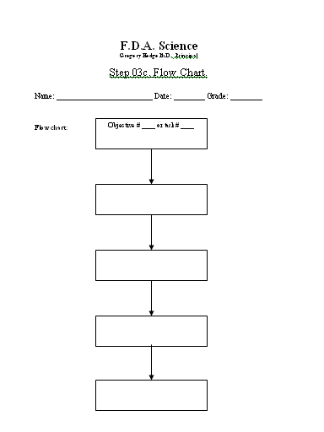
Flow Chart
This is similar to the Pert Chart but easier for H.S. students.
Leave space for notes on the side.
Notes:
FDA flow chart example

Slide 15
Flow Chart
Objective ____ or Task ____
Steps to complete

Slide 16
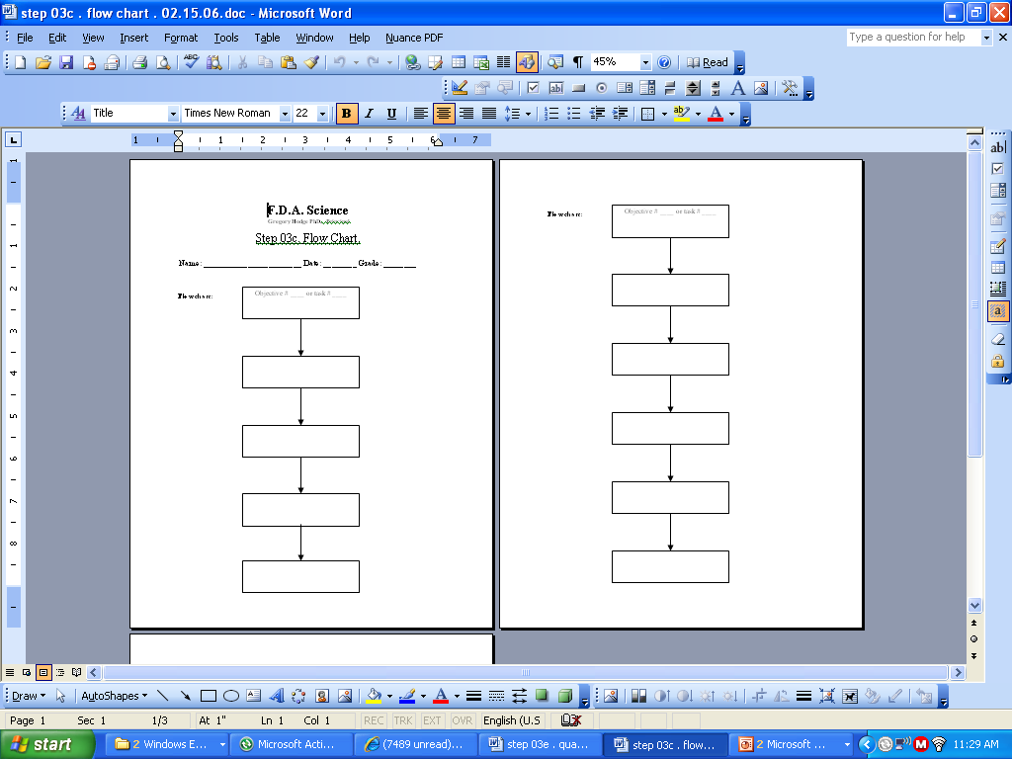
FLOW CHART
Task 01
Step 01
write materials on the sides
Step 02
write materials on the sides
Step 03
Step 04
Notes:
FDA flow chart example

Slide 17
Flow Charts
It helps you not do everything at the same time = disorganization. It gives you order.
It will help you make less mistakes.
You will manage your time better.
It will give you a chance to look back on your project and find a mistake in one of your steps.
Others will be able to duplicate your project easier.

Slide 18
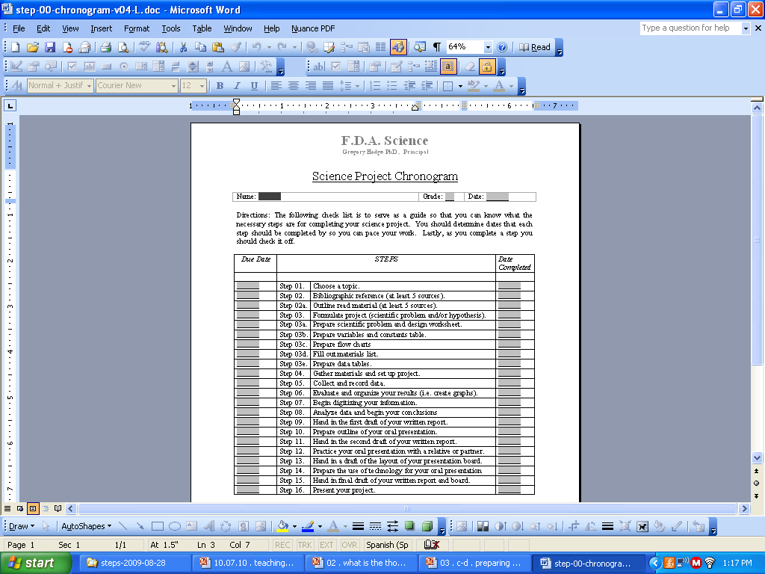
Chronogram Keeping Track of Time
Notes:
Organization example from FDA

Slide 19
Chronogram – Keeping Track of Time
Notes:
Organization example from FDA

Slide 20
Gantt Charts
Gantt charts are used to organize projects
Rows represent tasks
Columns represent time
Visually show sequences and timing
Assigns responsibility
Shows progress relative to planning
Notes:
Gantt charts are yet another way to visually organize projects. Is visually shows sequences, timing, can also be used to assign responsiblity.

Slide 21
Timelines - The Gantt Chart
Notes:
The tasks listed in a row and time is indicated on the columns. You can start from a month view or go by weeks. The shaded in blocks (or you can use X’s) show what has been completed. Different colors could represent different stages that task is at.

Slide 22
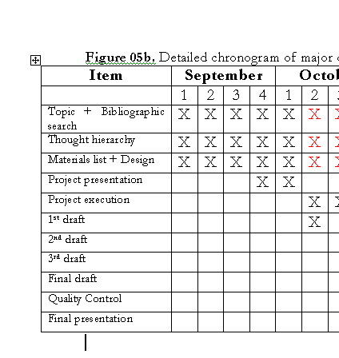
General Gantt Chart
Once the tasks have been identified in the previous steps they are written under the “item” category.

Slide 23
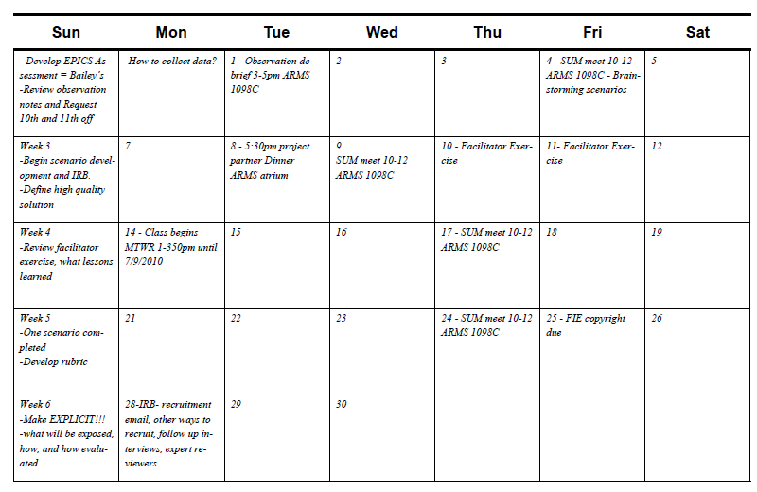
Calendars
Notes:
Calendars are also another good tool for visual learners. This is my calendar for this June. The way I came up with this was knowing where I wanted to be at the end of the summer and filled in the calendar backwards. So over to the left I have tasks for the week, and on the actual days I have what is scheduled.

Slide 24
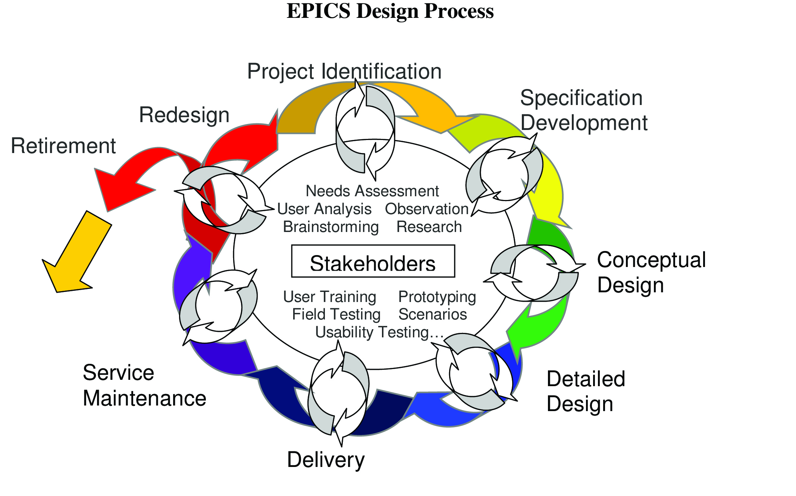
*Students should know where they are in the design process throughout their projects*

Slide 25
Follow up meetings
Students check progress of tasks or each step of the chronogram and Gantt chart one time per week.
Adjustments should be made during these meetings; new due dates set; unforeseen events clarified; new resources considered; etc.

Slide 26
Good Planning
Check points/milestones/gates
At this time, the following will be working…
Provides accountability and process checks
Are we on time?
Being honest with the team
Is a subgroup behind
“Not behind if we are ahead of the others…”
Honest appraisals
Short tasks that break things up
Notes:
See Design Process worksheet with phases and gates

Slide 27
Accountability
Short tasks allow team members to be accountable
Weekly tasks - what is due this week?
Prevent delays that span several weeks
Prompts students to seek help
Project managers can track % tasks completed by the week.
Keeps projects moving and shifting resources as needed

Slide 28
Questions?

